Slide 1
The Astrology of a New World Economy
Go to
http://www.crucialastrotools.co.uk/links.html
For live copy of this power point presentation
How effectively are economists and politicians reacting to the demand for realistic efficiency symbolized by the Pluto in Capricorn period?
Are post-2008 short term, debt-driven avoidance tactics leading to future disaster; especially for Western economies? Can vast Chinese capital expenditure really bring sustained growth?
Or we at the gateway of a new ethical world economy? Wise understanding of the astrology of the Pluto-in-Capricorn period makes this possible.
Friday 12.45 to 13.45 Bird/Road Runner Room​

Slide 2
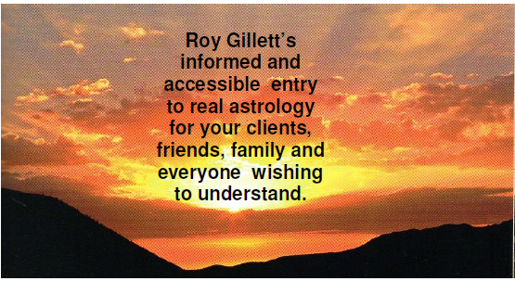
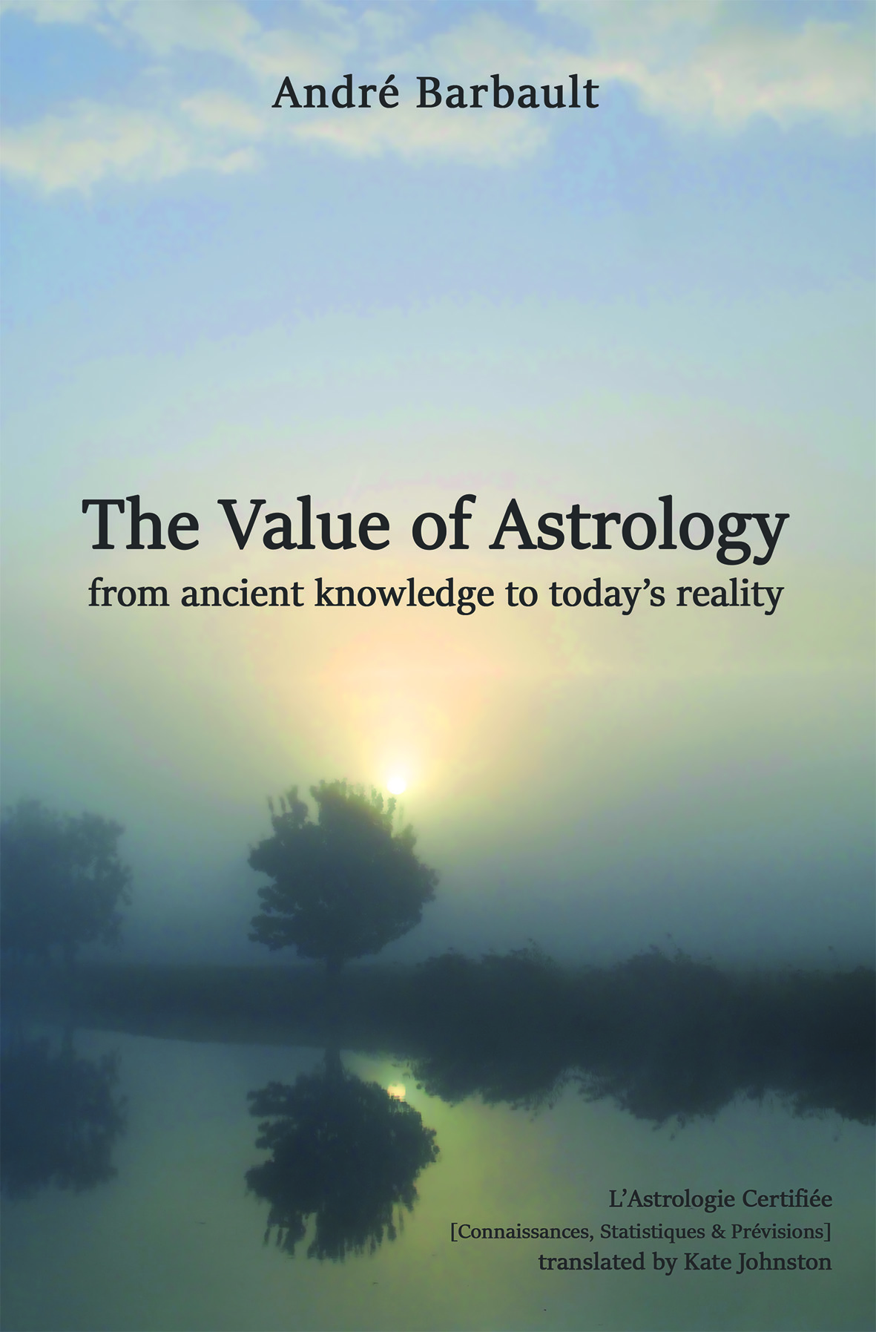
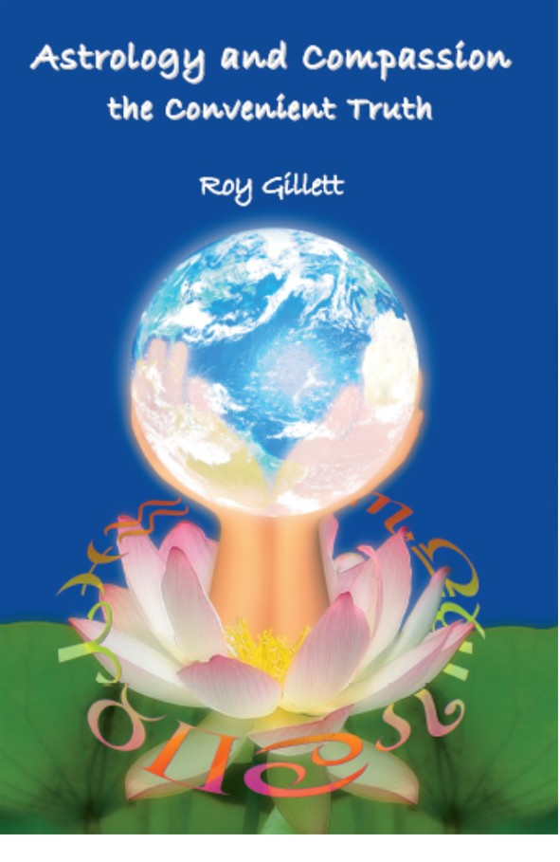
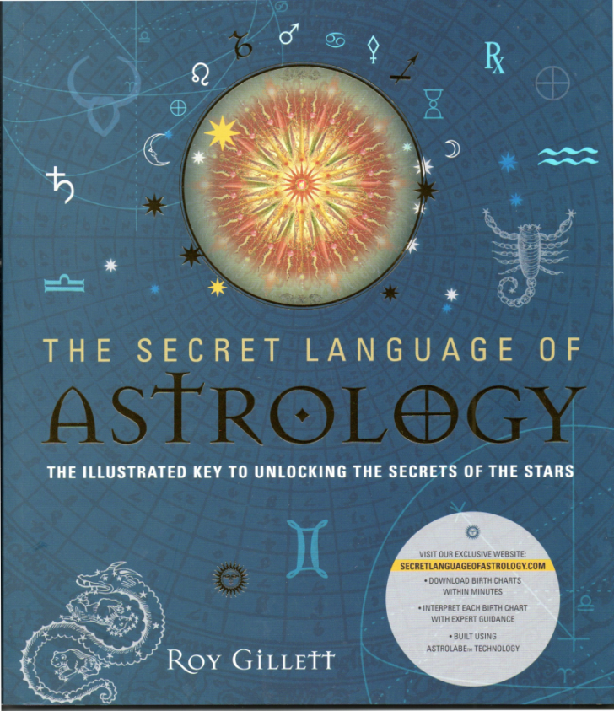
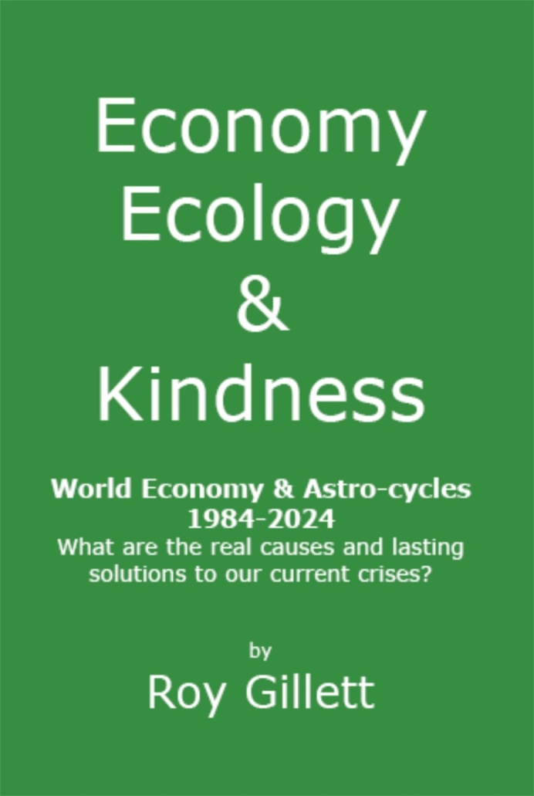
Coming soon
Reversing the Race to Global Destruction
Order books from online outlets and especially:
http://www.crucialastrotools.co.uk

Slide 3
Contents
The intrinsic nature of Free Market Enterprise Capitalism
Is this the basis of an efficient world economy?
Major market turning points and their relationship to the Uranus/ Pluto 90 degree multiple cycles and Earth Stellia
Taking stock of our actions to resolve 2008 crisis
[Jupiter\Saturn with other cycles]
Danger points in the future
Negative and positive ways of answering economic challenges
Practical ways to Reverse the Race to Global Destruction
Implications for the “American Dream”?

Slide 4
The intrinsic nature of Free Market Enterprise Capitalism

Slide 5
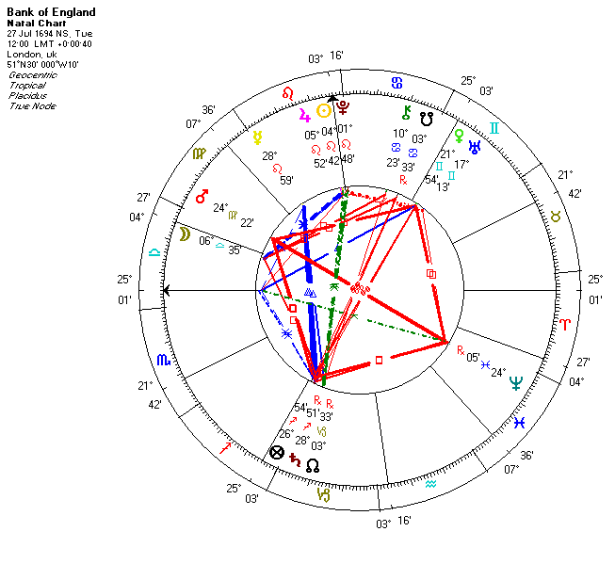

Slide 6
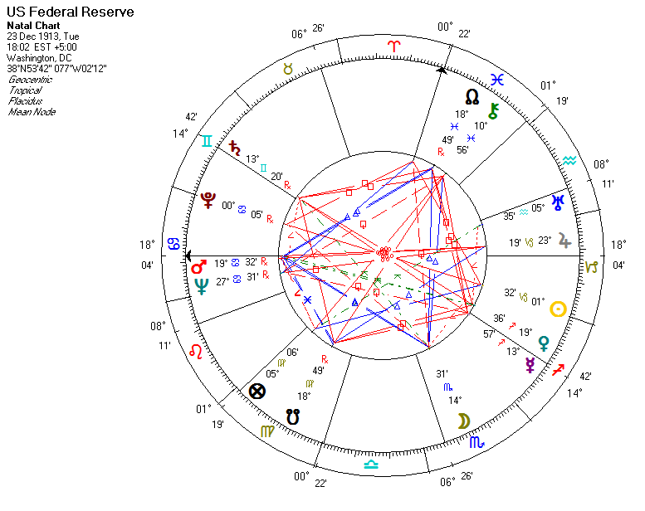

Slide 7
Is this the basis of an efficient world economy
People talking about the role of concepts such as kindness , integrity, caring for the planet and each other in what is known as the “hard-headed realities of the business world”, are often patronised as dreamy idealists, out of touch with reality.
The purpose of this talk is to show the astrology of macro-economics turns this notion on its head. It is the exploitative free-enterprise capitalists, who believe in the survival of the fittest, who seek to manipulate the rules, to trick and cheat themselves to riches and mastery over the world, that are the unrealistic dreamers; doomed to illusory moments of success, followed by ultimate failure in a dying world.
Efficient, lasting success comes when people prepare for change and the rise and fall of opportunity; all the time joyously cooperating with each other. By all means compete, but not to defeat others, rather to make them happier and encourage them to join in and do the same. The most successful businesses grow and flourish this way
Pluto is about fundamental transformation, out with everything that is inefficient and unsustainable , the death of all that is half –baked. Combined in a square with Uranus, it represents the death of every kind of insubstantial innovation.
Hence the Pluto in Capricorn years urge us towards a new sustainable world economic system based on cooperation – anything less will destroy us and our world.
Let’s have a look at the astrology and see if you agree with me!

Slide 8
Major market turning points and their relationship to the Uranus/ Pluto 90 degree multiple cycles and Earth Stellia

Slide 9
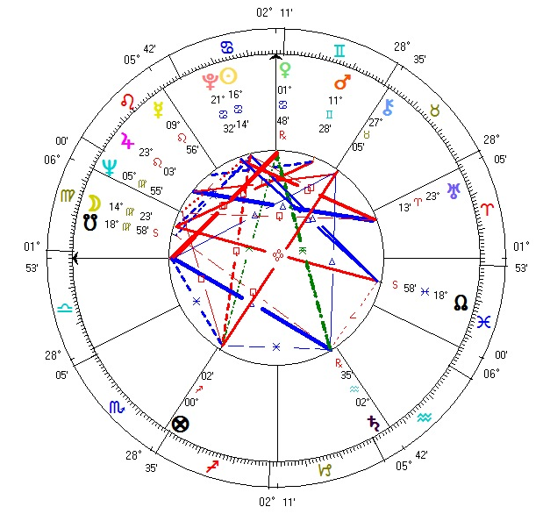
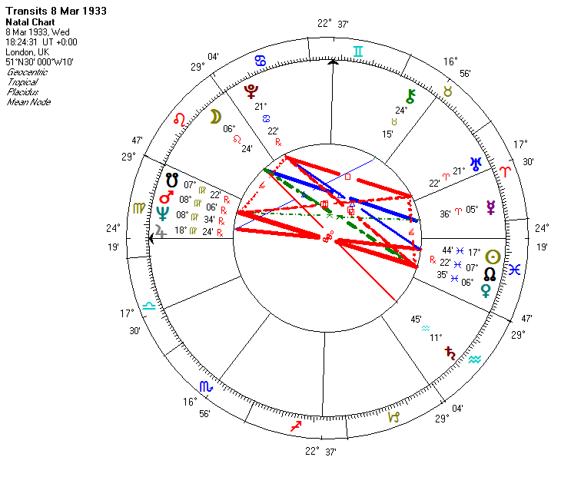
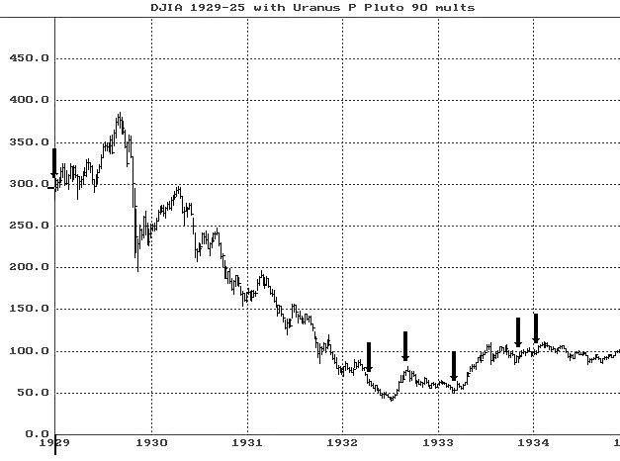

Slide 10
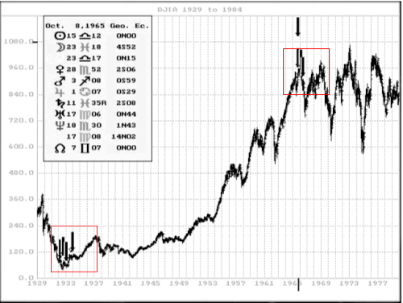

Slide 11
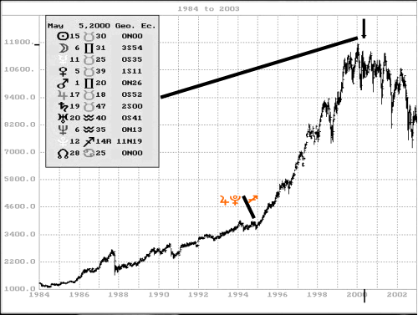
½in ƒ à¾¿À in‰
1989-92 Earth Stellium?? Victory of capitalism or just the failure of the Soviet form of common ownership?

Slide 12
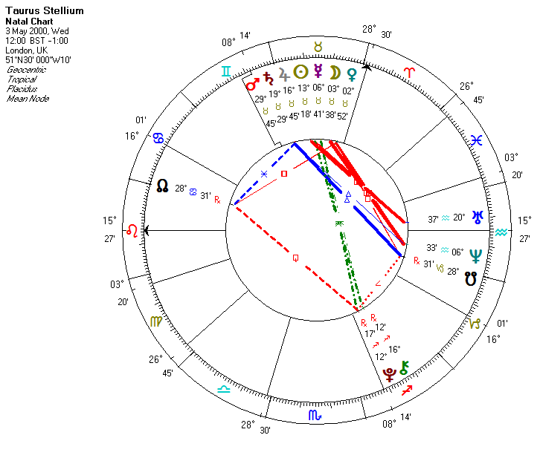

Slide 13
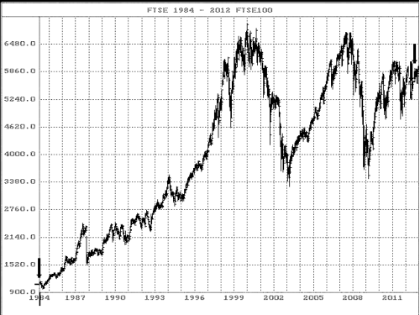
Á‰
¾ …à¿‹
Unavoidable reality
There must be a way around this.

Slide 14
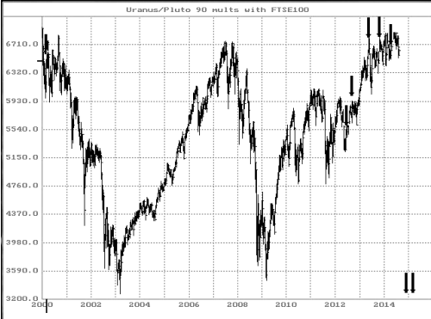
¿‘Á
Taurus Stelliam
Á‰

Slide 15
Taking stock of our actions to resolve 2008 crisis
In the immediate aftermath of the 2008 crisis [early 2009], my Economy Ecology and Kindness warned:
“Imagine just about every ‘quick trick’ to ‘restore confidence’, build up asset values and ‘get the show on the road’ continues to be attempted.
Governments still borrow enormous sums, print money, and accept liabilities they do not have the resources to cover. Any positive statistic is then laced with claims of ‘green shoots of recovery’.
With Jupiter hovering between Pisces and Aries until it enters Taurus in mid 2011 and Neptune hanging back in Aquarius until February 2012, it will be difficult to let go of hopes for a quick fix back to the past. Before a river finally dries up, there can be a deceptive moment when the water appears to rise.
To mistake such temporary rising stock prices or growth in consumption as recovery could in the end make matters much worse.”

Slide 16
Jupiter / Saturn Cycle
2000-2010 Waxing from conjunction to opposition = growth, danger of over-reaching. NB Pluto’s 2008 ingress into Capricorn marked early end to growth.
2010 – 2020 Waning from opposition to conjunction = consolidation, correction of over-reaching – attempts to expand are likely to whither, be unsustainable, or be patchy; bringing growth to the few at the expense of the many.
Ignoring this fundamental cycle sacrifices economic sustainability.
BUT this is exactly how equity markets behave.
Presented logarithmically (allowing for inflation) shows this clearly

Slide 17
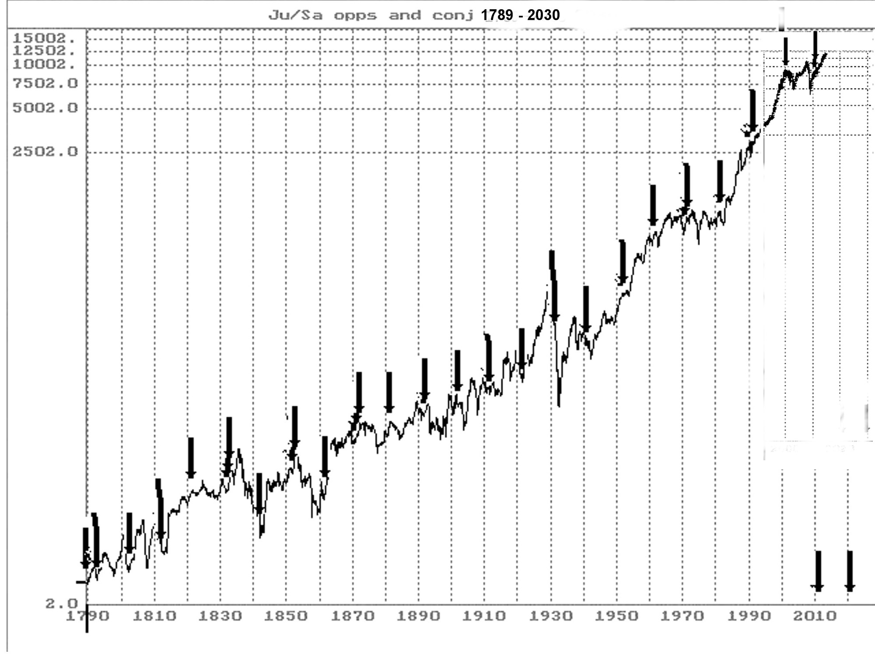

Slide 18
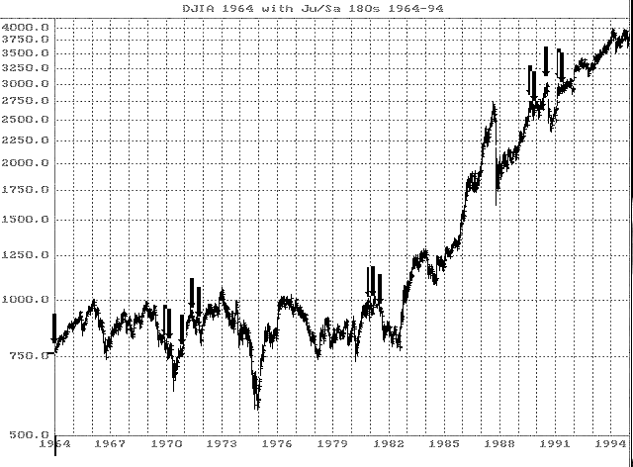

Slide 19
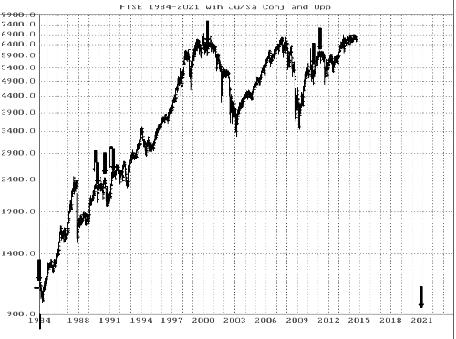
2000
Taurus
Stellium
+ JU/SA cnj
2012-15
seven
UR/Pl
squares
2008
Pluto
Capricorn
1995
Pluto
Sagittarius
1984
Pluto Scorpio

Slide 20
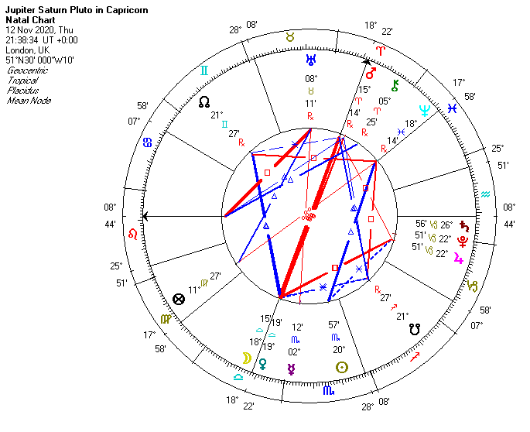
Danger point in the future
Time of truth that confronts all who have avoided economic realities.
Electional Search Results
Criteria: FIND (Jup in Cp) AND (Sat in Cp)
AND (Plu in Cp) AND (Jup Cnj Plu)
Search From 1 Jan 5001 BC to 1 Jan 5000
22 Jan 4573 BC 04:19:09
13 Jan 4336 BC 06:47:42
9 Mar 3838 BC 12:38:50
29 Feb 3601 BC 11:34:18
24 Apr 2866 BC 18:55:09
17 Aug 2866 BC 13:35:24
1 Dec 2866 BC 14:31:29
12 November 2020 21:38:39 (UT)
3 Mar 2755 14:37:19 (UT)
5 Aug 2755 18:01:51 (UT)
8 Oct 2755 23:09:37 (UT)
14 Dec 3253 17:48:03 (UT)
9 Jan 3490 03:47:42

Slide 21
Negative and positive ways of answering economic challenges
We make the worst use of the astro-events
and perpetuate the problem by.....
Putting business interests first to ‘win the global race’
Encouraging competitive educational standards
Encouraging consumer confidence and spending
Freeing up trade with China
Profiting through Arms trading
Reducing tax to attract overseas investment
Making short term savings by delaying fuel economy work.
Not affording ‘green policies’ and aid to poor countries
We start on the path to a better, more sustainable way by
Seeing through others’ eyes –however different –imagine living life as they do.
Prizing good personal relationships above possessions
Doing the right thing is more important than obeying the rules
Using the rules to take advantage of others is as bad as stealing from them
Working to create a world society where ‘Life, Liberty and the Pursuit of Happiness’ really is the central aim and any individual, business or government seeking to take personal advantage against the interests of others is seen and treated as a criminal.
This is not dreamy idealism, It is the efficient new system that Pluto demands to replace greed-based capitalism, reversing its futile economic race to global destruction.
When people cooperate, not compete with each other, economies are truly efficient.

Slide 22
Practical ways to Reverse the Race to Global Destruction
Computerising a new Gold Standard
Modern computer technology, with its intricate interconnected systems, has ideal economic tools to build a viable business structure from given principles and values. The concept of genuine intrinsic value we programme into the system must answer human and planetary ecological needs. Ethical principles must be established and adhered to by anyone devising and managing such a system. Not only can they not, but they would not wish to manipulate the system for personal reward. Their approach towards the principles would be no different than a doctor’s commitment to his Hippocratic Oath. As doctors should not kill patients, so accountants should not cheat society — whether or not their actions are within the rules. Aspiring constantly to improve situations, people will always be ready to give more than asked, if it leads to genuine, lasting benefit. To the general public, manipulating such a system for person gain would be as unacceptable as today we see the 19th century practices of public hanging, torture and child cruelty.
The only acceptable exchange measure would represent genuine giving and taking. Actions would increase in value as the benefit of an activity is maximised. Benefit would be measured in terms of ecological, human and social need, as well as the materials and work involved in production. This new Gold Standard would establish a minimum base value, but the emphasis would be upon this value ever-growing. The wish to give more than asked would be more and more common, because we are motivated by the happiness of others and the realities of living on the planet. Crucially, it would be this enhanced prized value of the unit that we focus around, not rules and laws enforced by an authoritarian hierarchy and its legal advisers. Our ‘currency’ would be centred upon the measure of trust and freedom that enables diversity — the notion of giving without counting the cost, of giving more than is asked. This is the way to genuine, lasting economic success.
Page 84-5 Roy Gillett Ecology Economy and Kindness (Pub 2009)

Slide 23
Is not this the pursuit of the essential meaning the founders meant by The American Dream - ‘Life, Liberty and the Pursuit of Happiness’ ?
It will take time. All great changes in human history start with small steps that encourage people to lean in the right direction.
sitting on the ‘wrong’ seat
Enrolling in the ‘wrong’ school
landing in a new alien country
saying no to unjust taxes
abolishing public lynching...
banning torture
As we turned away from slavery, so can we start to turn away from economic manipulation and exploitation of the innocent and vulnerable and move toward an efficient, ethical and kind world economy.
Pluto will respond positively to nothing less!

Slide 24
Coming soon
Reversing the Race to Global Destruction
Order books from online outlets and especially:
http://www.crucialastrotools.co.uk

